Slide 1
Measures of Atmospheric Moisture

Slide 2
Mass vs. Volume vs. Pressure
Meteorologists measure the actual amount of water in the air based on various factors:
Vapor pressure (based on pressure)
Mixing ratio (based on mass)
Specific humidity (based on volume)
There are other measures that describe different aspects of humidity:
Relative humidity (percent saturation)
Dew point (temperature at saturation)
All of these measures are used in different ways.

Slide 3
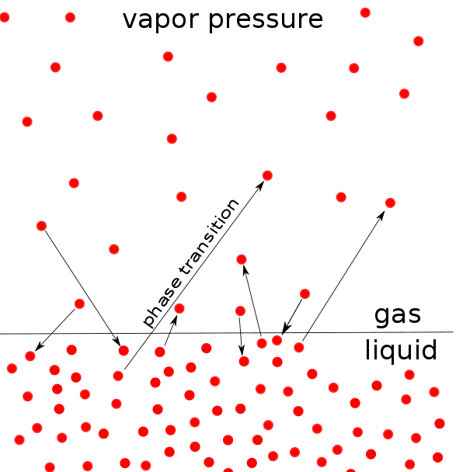
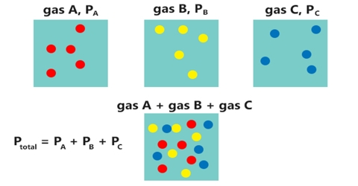
Vapor Pressure
The total pressure of a mixture of gases is equal to the sum of the pressures of the individual gases.
Vapor pressure is the pressure exerted by just the water vapor.

Slide 4
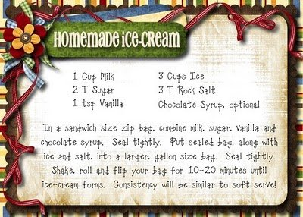
Mixing Ratio
The mixing ratio describes the mass of water vapor in the air relative to the total mass of all the other components of the air.
Similar to listing water vapor as a single component of a recipe!
Water Vapor

Slide 5
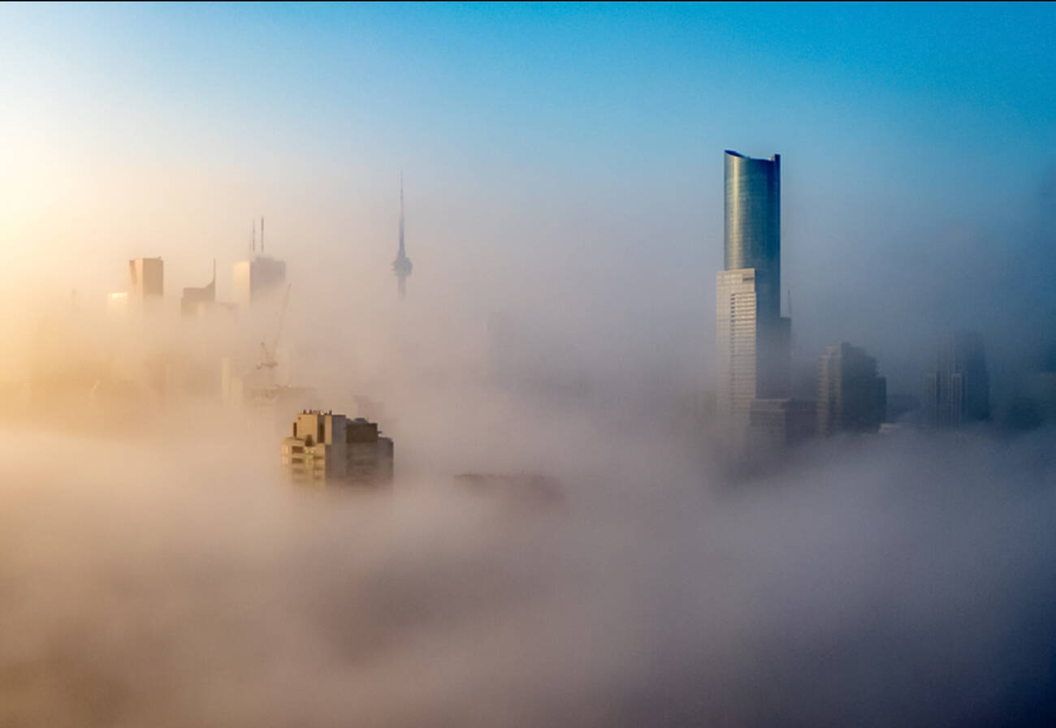
Moisture and Saturation
While vapor pressure and mixing ratio describe how much water vapor is in the air, the number doesn’t make much sense by itself.
Usually, the values are compared to potential values if the air were saturated.
Let’s meteorologists know how much water is needed before saturation is reached.
Notes:
Pressure of the vapor
What is air

